Slide 1


Projects Tracker
John Hill & Mark McGill
Last Updated April 2023

Slide 2
About You This information will help your supervisor to understand your background, skillset and interests Optional – Include a photo of yourself below
Question | Your Response
Is there a name other than your first name as noted with the University that you would prefer to be used by your supervisor in your contact with them? | Nader
Please state any relevant background information you would like your supervisor to know. | None
Please state what previous programming experience (languages, frameworks etc) that you have beyond the current degree, if any. | Haskell, Numpy.
Please briefly note what future career aspirations you have (e.g. programmer, business analyst, consultant, ...), and what job role you are targeting (e.g. finance, government, technology, academia, ...) after this degree. | Business Manager

Slide 3
UGSupportBot
To be updated as the topic and scope become clearer from Week 1 onwards

Slide 4
Proposed Project
Question | Your Response
Describe your project topic, aim(s) and objectives considering: what the development project would aim to produce what are the objectives? | Must Have : Basic Chat Functionality : The chatbot must be able to engage in text-based conversations with users, responding to their queries and providing relevant information. Chatbot Logic : The Chatbot must process user queries, provide accurate responses, and interface with the support service data. Web Interface : There must be a web-based interface accessible to students for interacting with the chatbot. Natural Language Processing : The chatbot must employ natural language processing (NLP) techniques to understand and interpret user inputs accurately. Database for Support Service Data : The chatbot must store information related to support services, including their features and data. Should Have: Documentation : There should be documentation to guide users on how to use the chatbot and provide information for future reference. User Feedback Collection : There should be a mechanism to collect user feedback for future improvements to the chatbot. Integration with APIs : The chatbot should integrate with relevant external APIs or data sources to provide up-to-date information and services. For example, ChatGPT. Multilingual Support : The chatbot consider adding support for multiple languages to reach a broader user base. Could Have : Voice Input and Output : The chatbot could add voice recognition and synthesis for a more immersive user experience. Register and Login Page: The chatbot could contain register and login pages for users. Error Handling : The chatbot could implement robust error handling to gracefully handle user queries that the chatbot cannot answer or misunderstands. Won’t Have : Mobile Application : Omit the development of a dedicated mobile application for accessing the chatbot, focusing on web accessibility.

Slide 5
Changes to Proposed Project As you progress through the 22 week project, keep a note of any changes to the proposed project topic, aims, technologies used etc. here. This will help your supervisor to understand how the project has evolved and why.
How did the project topic / aims / objectives change? | When did this change occur? (week / date) | Why did you make this change? | Has this been discussed with Supervisor?

Slide 6
URLs / Resources Link to any useful URLs and resources you want to share directly with your supervisor here. This should include a link to your Gitlab repository (once setup) and the latest working copy of your dissertation (e.g. on Onedrive, Overleaf etc).
Remember, both your Gitlab repository and Dissertation should evidence regular, continual progress throughout the 22 weeks (e.g. history of regular commits evidencing you developed your project independently and incrementally).

Slide 7
Understanding Proposed Project
Question | Your Response
Have you completed background research (literature review)? Provide the key topics you will write about in your dissertation | Chatbots in Higher Education: Exploring the use of chatbots in the higher education sector, including universities and colleges, to enhance support services and student experiences. AI in Student Support: Investigating the broader use of artificial intelligence (AI) and natural language processing (NLP) in providing support services to students in academic institutions. Privacy and Ethical Considerations: Examining literature on the ethical and privacy implications of implementing AI-driven chatbots in academic environments and strategies for addressing these concerns. NLP and Chatbot Technologies: Studying the latest developments and trends in NLP and chatbot technologies, which can be applied to create an effective chatbot for student support.
Which existing or similar applications have you reviewed? | ChatGPT, Bing AI, Bard AI, IBM Watson Assistant
What type of application (e.g. Web app, Mobile app, Desktops app, Service/API, Cloud app etc.) are you going to develop? | Web app
Have you created a list of your functional requirements? | Support Service Information: The chatbot must provide detailed information about the university's support services, including their scope and availability. Service Selection and Guidance: Users should be able to easily select specific support services through guided options. User Queries and Responses: The chatbot must effectively understand and respond to user queries related to support services. Documentation and Help Resources: Provide user documentation and help resources to guide users in utilizing the chatbot effectively.
What technologies are you going to develop using? (e.g. what framework, stack, programming languages etc). | Python, HTML, CSS, Flask, possibly NLP

Slide 8
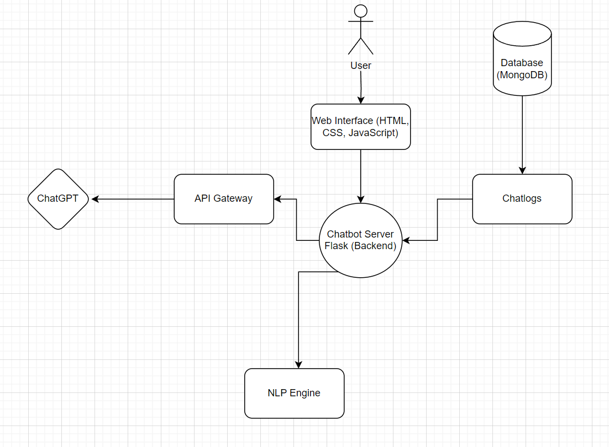
Project Architecture Diagram Add and maintain an architecture diagram to help your supervisor understand your project design and approach

Slide 9
Weekly Progress Tracker To be filled out by the student every week, tracking progress, aims, issues, and planning your agenda for any meetings with your supervisor.

Slide 10
Purpose of the Progress Tracker
The progress tracker is here to help you manage your project – to set targets, explore expectations and aims with your supervisor, and organise and document your thoughts and progress along the way
Each week has an associated progress tracker slide that should be filled out week-by-week.
There are also “status update” slides aligned with the mandatory supervisor meetings throughout the project. These should also be filled prior to meeting your supervisor to evidence your progress.
You can modify this template! Adapt it to suit your project needs as you go!
Filling out the Weekly Progress Tracker and Status Update slides is mandatory – If you don’t fill this material out, this will count against your professional conduct grade.

Slide 11
Week 1 – Initial Supervisor Meeting
Key Milestones | Status
Project Topic & High Level scope
Requirements / Analysis
Tools, Stack, Dev. Environment
Prototype and Design
Development
System testing
User Evaluations
Dissertation & Video
Key
Meeting Agenda (if scheduled for this week)
Introduction Weekly Todo Plan for the Semester
 | Not Started
 | On track
 | Issues
 | Major issues
 | Completed
Completed Activities This week
Understanding how everything works Making sure I submit weekly updates to supervisor
Upcoming Activities – Next week
Setting up version control with the templates. Looking for software technologies and tools to use for the project.
Issues, Risks and Concerns
Still new to the whole process and it is confusing.

Slide 12
Week 2
Key Milestones | Status
Project Topic & High Level scope
Requirements / Analysis
Tools, Stack, Dev. Environment
Prototype and Design
Development
System testing
User Evaluations
Dissertation & Video
Key
Meeting Agenda (if scheduled for this week)
Plan for the semester. Talking about the design element.
 | Not Started
 | On track
 | Issues
 | Major issues
 | Completed
Completed Activities This week
Choosing a topic to create a product. Looking for software technologies and tools to use for the project.
Upcoming Activities – Next week
Creating GitHub Project. Integrating the template into the project. Inviting the Supervisor
Issues, Risks and Concerns
Still relatively new to the weekly tasks needed to be done.

Slide 13
Week 3/4 Status Update
Gannt Chart Done.
Project requirement using Moscow approach Done.
System architecture diagram Done.
Minutes Record Up to Date.
Wireframe Done
Supervisor discussions Up to Date.
GitHub Setup Ready.
Overleaf is yet to be integrated with Github.

Slide 14
Week 3
Key Milestones | Status
Project Topic & High Level scope
Requirements / Analysis
Tools, Stack, Dev. Environment
Prototype and Design
Development
System testing
User Evaluations
Dissertation & Video
Key
Meeting Agenda (if scheduled for this week)
Completed activities. Upcoming Activities. A more specific chatbot than a broad one.
 | Not Started
 | On track
 | Issues
 | Major issues
 | Completed
Completed Activities This week
Created GitHub Project. Integrated the template into the project. Invited the Supervisor.
Upcoming Activities – Next week
Focusing on the wireframes on how the web app could look like. Writing the Moscow requirements.
Issues, Risks and Concerns
A little late to the design part

Slide 15
Week 4
Key Milestones | Status
Project Topic & High Level scope
Requirements / Analysis
Tools, Stack, Dev. Environment
Prototype and Design
Development
System testing
User Evaluations
Dissertation & Video
Key
Meeting Agenda (if scheduled for this week)
Completed Activities Upcoming Activities Finalizing design part
 | Not Started
 | On track
 | Issues
 | Major issues
 | Completed
Completed Activities This week
System Architecture update Sequence Diagram Use case Diagram Wireframe
Upcoming Activities – Next week
Starting Development Using NLP technology as well as Flask Developing the web application part
Issues, Risks and Concerns
Still need to learn some technologies for development.

Slide 16
Week 5
Key Milestones | Status
Project Topic & High Level scope
Requirements / Analysis
Tools, Stack, Dev. Environment
Prototype and Design
Development
System testing
User Evaluations
Dissertation & Video
Key
Meeting Agenda (if scheduled for this week)
Completed Activities Upcoming Activities Checking development status
 | Not Started
 | On track
 | Issues
 | Major issues
 | Completed
Completed Activities This week
Preparing the folder structure Started the web application part Setting up most of the stuff required for coding
Upcoming Activities – Next week
More intense coding with Python, HTML, CSS, JavaScript and other programming languages.
Issues, Risks and Concerns
No Issues, Risks, and Concerns.

Slide 17
Week 6/7 Status Update
Finished Design Planning
Started the basics of developing.
Got used to Weekly to do tasks.
Still working on keeping up the Schedule.
Working on the basic UI and JavaScript .

Slide 18
Week 6
Key Milestones | Status
Project Topic & High Level scope
Requirements / Analysis
Tools, Stack, Dev. Environment
Prototype and Design
Development
System testing
User Evaluations
Dissertation & Video
Key
Meeting Agenda (if scheduled for this week)
Completed Activities Upcoming Activities Checking development status
 | Not Started
 | On track
 | Issues
 | Major issues
 | Completed
Completed Activities This week
Started Development Working on HTML, Javascript for the project Developed a UI interface with buttons including reset and back.
Upcoming Activities – Next week
Hopefully it should be more interactive by clicking the buttons and leading somewhere useful.
Issues, Risks and Concerns
None

Slide 19
Week 7
Key Milestones | Status
Project Topic & High Level scope
Requirements / Analysis
Tools, Stack, Dev. Environment
Prototype and Design
Development
System testing
User Evaluations
Dissertation & Video
Key
Meeting Agenda (if scheduled for this week)
Completed Activities Upcoming Activities Checking development status
 | Not Started
 | On track
 | Issues
 | Major issues
 | Completed
Completed Activities This week
Started working on NLP, Pytorch, NlTK. Started HTML, Javascript
Upcoming Activities – Next week
Still Working on NLP, Pytorch, NlTK. Adding more HTML, Javascript files.
Issues, Risks and Concerns

Slide 20
Week 8/9 Status Update
Finished Design Planning
Started developing.
Got used to Weekly to do tasks.
Still working on keeping up the Schedule.
Working on the HTML and CSS and JavaScript .
Started using pytorch, NLP, NLTK.

Slide 21
Week 8
Key Milestones | Status
Project Topic & High Level scope
Requirements / Analysis
Tools, Stack, Dev. Environment
Prototype and Design
Development
System testing
User Evaluations
Dissertation & Video
Key
Meeting Agenda (if scheduled for this week)
Completed Activities Upcoming Activities Checking development status
 | Not Started
 | On track
 | Issues
 | Major issues
 | Completed
Completed Activities This week
Still working on NLP, Pytorch, NlTK. Adding more HTML, Javascript files Editing CSS Experimenting with the dynamic conversation bot
Upcoming Activities – Next week
Perfecting the conversational bot Hopefully able to add the Intents in the intents.json
Issues, Risks and Concerns

Slide 22
Week 9
Key Milestones | Status
Project Topic & High Level scope
Requirements / Analysis
Tools, Stack, Dev. Environment
Prototype and Design
Development
System testing
User Evaluations
Dissertation & Video
Key
Meeting Agenda (if scheduled for this week)
Christmas Break
 | Not Started
 | On track
 | Issues
 | Major issues
 | Completed
Completed Activities This week
Upcoming Activities – Next week
Issues, Risks and Concerns

Slide 23
Week 10/11 Status Update

Slide 24
Week 10
Key Milestones | Status
Project Topic & High Level scope
Requirements / Analysis
Tools, Stack, Dev. Environment
Prototype and Design
Development
System testing
User Evaluations
Dissertation & Video
Key
Meeting Agenda (if scheduled for this week)
Christmas Break
 | Not Started
 | On track
 | Issues
 | Major issues
 | Completed
Completed Activities This week
Upcoming Activities – Next week
Issues, Risks and Concerns

Slide 25
Week 11
Key Milestones | Status
Project Topic & High Level scope
Requirements / Analysis
Tools, Stack, Dev. Environment
Prototype and Design
Development
System testing
User Evaluations
Dissertation & Video
Key
Meeting Agenda (if scheduled for this week)
Christmas Break
 | Not Started
 | On track
 | Issues
 | Major issues
 | Completed
Completed Activities This week
Upcoming Activities – Next week
Issues, Risks and Concerns

Slide 26
Week 12/13 Status Update
Working with UI
Working with CUDA
Using a large language model from Huggingface 7 Billion parameters
Installing all the essential libraries
Finding ways for Fine tuning
Working on the dissertation

Slide 27
Week 12
Key Milestones | Status
Project Topic & High Level scope
Requirements / Analysis
Tools, Stack, Dev. Environment
Prototype and Design
Development
System testing
User Evaluations
Dissertation & Video
Key
Meeting Agenda (if scheduled for this week)
Christmas Break
 | Not Started
 | On track
 | Issues
 | Major issues
 | Completed
Completed Activities This week
Upcoming Activities Remaining
Issues, Risks and Concerns

Slide 28
Week 13
Key Milestones | Status
Project Topic & High Level scope
Requirements / Analysis
Tools, Stack, Dev. Environment
Prototype and Design
Development
System testing
User Evaluations
Dissertation & Video
Key
Meeting Agenda (if scheduled for this week)
Christmas Break
 | Not Started
 | On track
 | Issues
 | Major issues
 | Completed
Completed Activities This week
Upcoming Activities Remaining
Issues, Risks and Concerns

Slide 29
Week 14/15 Status Update
After Posting a PDF containing the Data it will answer using the data by turning the long texts into chunks and to embed it later.
Fixing UI and adding Test and DB files.
Trying to create a chat History as per requirement.
Trial and Error.
Doing the Dissertation.

Slide 30
Week 14
Key Milestones | Status
Project Topic & High Level scope
Requirements / Analysis
Tools, Stack, Dev. Environment
Prototype and Design
Development
System testing
User Evaluations
Dissertation & Video
Key
Meeting Agenda (if scheduled for this week)
Completed Activities Upcoming Activities Checking development status
 | Not Started
 | On track
 | Issues
 | Major issues
 | Completed
Completed Activities This week
UI stuff is being made but still needs improvement Chat functionality with PDF
Upcoming Activities Remaining
Improving UI Adding DB Managing the files more accurately
Issues, Risks and Concerns
Code is limited to strong GPU

Slide 31
Week 15
Key Milestones | Status
Project Topic & High Level scope
Requirements / Analysis
Tools, Stack, Dev. Environment
Prototype and Design
Development
System testing
User Evaluations
Dissertation & Video
Key
Meeting Agenda (if scheduled for this week)
Completed Activities Upcoming Activities Understanding evaluation techniques
 | Not Started
 | On track
 | Issues
 | Major issues
 | Completed
Completed Activities This week
Minor Fixes for UI Starting Evaluation
Upcoming Activities Remaining
Still looking for ways for deploying with high GPU enviroment,.
Issues, Risks and Concerns
Deploying my code in a website.

Slide 32
Week 16/17 Status Update
UI almost done
Chroma database done
Database embeddings done
Accurate answer based on documentation
Survey Done
Still need to choose preferred UI for deployment

Slide 33
Week 16
Key Milestones | Status
Project Topic & High Level scope
Requirements / Analysis
Tools, Stack, Dev. Environment
Prototype and Design
Development
System testing
User Evaluations
Dissertation & Video
Key
Meeting Agenda (if scheduled for this week)
Completed Activities Upcoming Activities Checking evaluation
 | Not Started
 | On track
 | Issues
 | Major issues
 | Completed
Completed Activities This week
Completed most of Frontend Files like welcomepop.js, chatbox,js and more are essential for a working app.
Upcoming Activities Remaining
Backend coherent convo Multiple language support
Issues, Risks and Concerns

Slide 34
Week 17
Key Milestones | Status
Project Topic & High Level scope
Requirements / Analysis
Tools, Stack, Dev. Environment
Prototype and Design
Development
System testing
User Evaluations
Dissertation & Video
Key
Meeting Agenda (if scheduled for this week)
Completed Activities Upcoming Activities Finalizing evaluation
 | Not Started
 | On track
 | Issues
 | Major issues
 | Completed
Completed Activities This week
Deployment Starting the evaluation and finalizing it
Upcoming Activities Remaining
Working on the dissertation
Issues, Risks and Concerns

Slide 35
Week 18/19 Status Update
Frontend Done
Backend Done
Deployment Done
Evaluation Done
Going through the dissertation

Slide 36
Week 18
Key Milestones | Status
Project Topic & High Level scope
Requirements / Analysis
Tools, Stack, Dev. Environment
Prototype and Design
Development
System testing
User Evaluations
Dissertation & Video
Key
Meeting Agenda (if scheduled for this week)
 | Not Started
 | On track
 | Issues
 | Major issues
 | Completed
Completed Activities This week
Upcoming Activities Remaining
Issues, Risks and Concerns

Slide 37
Week 19
Key Milestones | Status
Project Topic & High Level scope
Requirements / Analysis
Tools, Stack, Dev. Environment
Prototype and Design
Development
System testing
User Evaluations
Dissertation & Video
Key
Meeting Agenda (if scheduled for this week)
Completed Activities Upcoming Activities Dissertation Readme Presentation
 | Not Started
 | On track
 | Issues
 | Major issues
 | Completed
Completed Activities This week
Majority of the dissertation Got 4 evaluations Deployment I successful using render and vercel.
Upcoming Activities Remaining
Completing the rest of the implementation, evaluation and conclusion.
Issues, Risks and Concerns

Slide 38
Week 20/21 Status Update
Working on the Dissertation
Finished Features
Finished Unit Testing
Planning to meet groups for the evaluation.
Doing the Video presentation.

Slide 39
Week 20
Key Milestones | Status
Project Topic & High Level scope
Requirements / Analysis
Tools, Stack, Dev. Environment
Prototype and Design
Development
System testing
User Evaluations
Dissertation & Video
Key
Meeting Agenda (if scheduled for this week)
Completed Activities Upcoming Activities Dissertation
 | Not Started
 | On track
 | Issues
 | Major issues
 | Completed
Completed Activities This week
Completed 3 Major Dissertation Sections Almost finished the coding needed.
Upcoming Activities Remaining
Finishing the last parts of the dissertation and refining it. Need to do group evaluations.
Issues, Risks and Concerns

Slide 40
Week 21
Key Milestones | Status
Project Topic & High Level scope
Requirements / Analysis
Tools, Stack, Dev. Environment
Prototype and Design
Development
System testing
User Evaluations
Dissertation & Video
Key
Meeting Agenda (if scheduled for this week)
Completed Activities Upcoming Activities Dissertation Presentation
 | Not Started
 | On track
 | Issues
 | Major issues
 | Completed
Completed Activities This week
Completed 4 Major Dissertation Sections Finished all the coding needed.
Upcoming Activities Remaining
Finishing the last parts of the dissertation and refining it. Need to do group evaluations.
Issues, Risks and Concerns

Slide 41
Week 22
Key Milestones | Status
Project Topic & High Level scope
Requirements / Analysis
Tools, Stack, Dev. Environment
Prototype and Design
Development
System testing
User Evaluations
Dissertation & Video
Key
Meeting Agenda (if scheduled for this week)
 | Not Started
 | On track
 | Issues
 | Major issues
 | Completed
Completed Activities This week
Upcoming Activities Remaining
Issues, Risks and Concerns

